Slide 1
Perceptrons, Neural Nets

Slide 2
Review from last time
Understood how gradient descent can be used to learn model weights to train a linear model
Discussed how gradient descent makes use of loss functions
The gradient of the loss with respect to a weight lets us know how that weight needs to be updated
In which direction is the slope – positive or negative?
How steep is the slope – how much do we need to modify the weight by?
Often used with a step size multiplyer to facilitate finding the minimum loss more quickly

Slide 3
In this lecture we will
Neurons
Discussed biological neurons
Introduce artificial neurons and their applications
Perceptrons
Introduce perceptrons as a unit of neural nets
Discuss perceptron activation functions, and how they are trained
Illustrate decision-making with perceptrons
Neural Nets
Introduce neural nets
Illustrate how neural nets can be used for computer vision problems

Slide 4
Review of binary classification
We’ve seen some functions that try to generate a binary classification
Sigmoid function, for example
Switching gears to biology, we can think of this decision as an activation
Either the neuron fires, or it doesn’t
Let’s think about some examples from biology…
Researchers have been trying to emulate the human brain using a computer for decades
Long before modern deep learning (of the past ~5 years) took off in practical applications
A neuron is not only the basic building block of the brain: it has also been used as a basic building block of artificial intelligence
We are nowhere near creating an artificial human brain (in code) that learns like children and humans do :-)

Slide 5
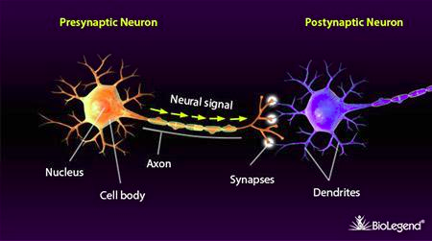
The biological neuron: an inspiration
How does a neuron work?
Dendrites are electric inputs from other cells
The cell body “collects” these inputs; when there is enough to activate the neuron, it fires
The axon outputs the activation to other neurons nearby
Synapses, using neurotransmitters, control how much of that activation is or is not propagated to nearby neurons
Image from https://www.biolegend.com/en-gb/synaptic-function

Slide 6
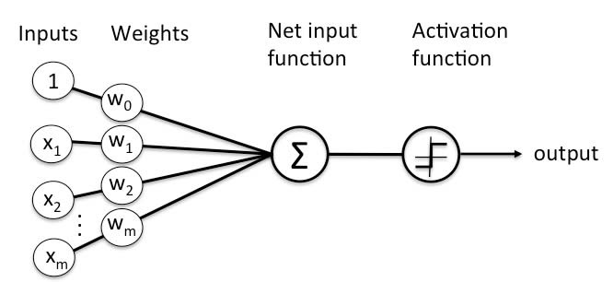
The perceptron: an artificial neuron
How does a perceptron model a neuron?
Dendrites are electric inputs from other cells: INPUTS
Synapses, using neurotransmitters, control how much of that activation is or is not propagated to nearby neurons : WEIGHTS
The cell body “collects” these inputs : DENDRITES
When there is enough to activate the neuron, it fires : ACTIVATION FUNCTION
The axon outputs the activation to other neurons nearby: OUTPUT
Image from https://www.simplilearn.com/tutorials/deep-learning-tutorial/perceptron, Image from https://www.biolegend.com/en-gb/synaptic-function

Slide 7


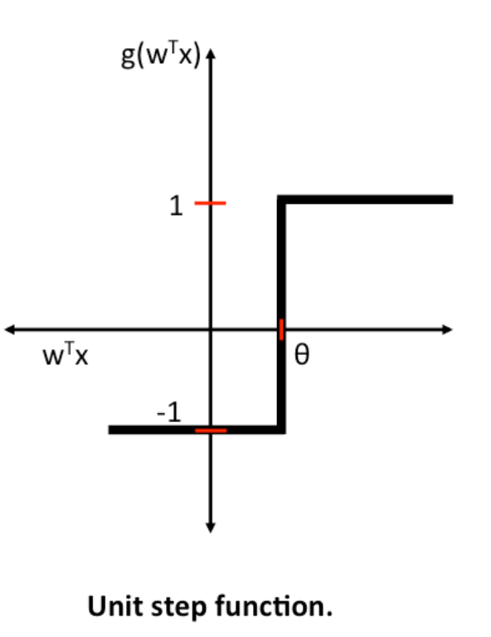
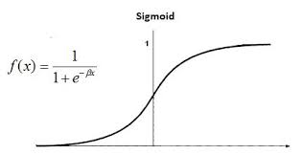
The perceptron: a building block of neural nets
A perceptron can be used as a binary classifier (if linearly separable data)
Outputs a boolean value
The weighted inputs are summed and passed to an activation function
For example, the perceptron can fire when these weighted inputs are greater than 0 (or not fire otherwise) -- here firing means return a 0 or 1, or returning a 1 or -1
For example, we could use a sigmoid function (like in Logistic Regression) to “convert” the weighted inputs into either a 0 or 1 (or a probability)
Images from https://www.simplilearn.com/tutorials/deep-learning-tutorial/perceptron, https://sebastianraschka.com/Articles/2015_singlelayer_neurons.html

Slide 8

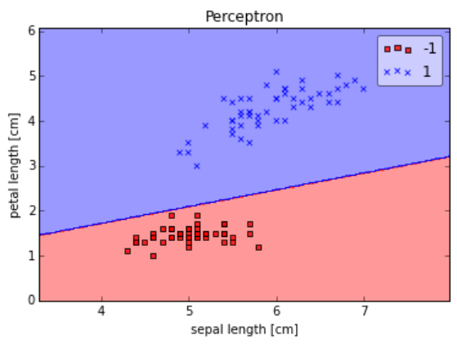
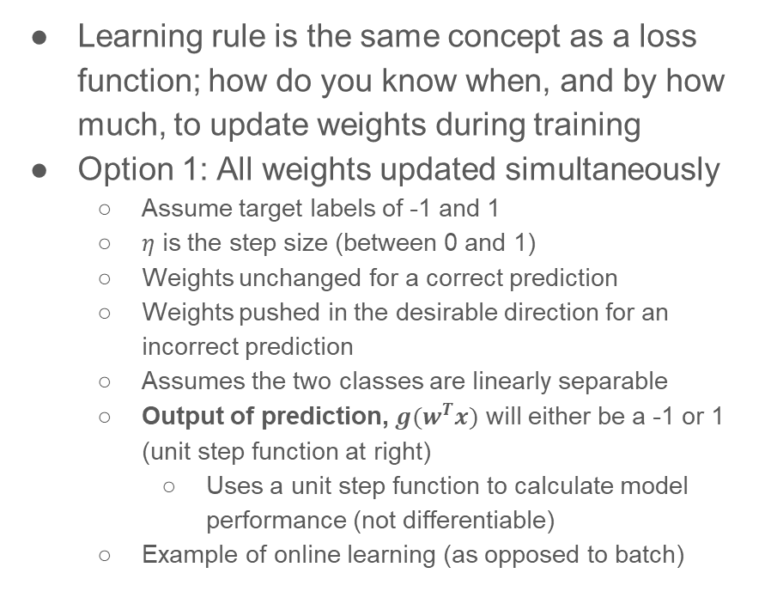

Learning rules for perceptrons
Images from https://sebastianraschka.com/Articles/2015_singlelayer_neurons.html
The change to $w$
step size
Learning rule is the same concept as a loss function; how do you know when, and by how much, to update weights during training
Option 1: All weights updated simultaneously
Assume target labels of -1 and 1
$η$ is the step size (between 0 and 1)
Weights unchanged for a correct prediction
Weights pushed in the desirable direction for an incorrect prediction
Assumes the two classes are linearly separable
Output of prediction, $g(w^{T}x)$ will either be a -1 or 1 (unit step function at right)
Uses a unit step function to calculate model performance (not differentiable)
Example of online learning (as opposed to batch)
error

Slide 9
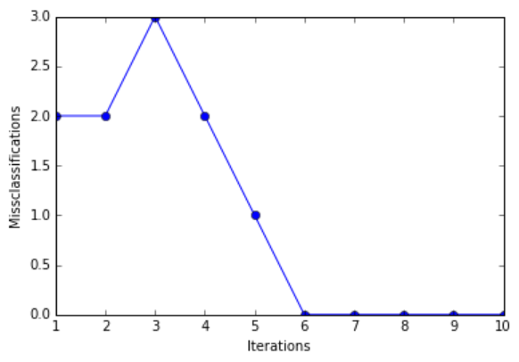
Training a perceptron: example of Option 1 (prev slide)
train_samples has a row for each sample, with its last column being the ground truth target
First weight is the bias
def train_weights(train_samples, step_size, max_iterations):
weights = [0.0 for i in range(len(train_samples[0]))]
for iteration in range(max_iterations):
for row in train_samples:
prediction = activation(row, weights) #returns 0 or 1
score = row[-1] - prediction # row[-1] is target
weights[0] = weights[0] + step_size * score # update intercept/bias
for i in range(len(row)-1):
weights[i + 1] = weights[i + 1] + step_size * score * row[i]
return weights # weights[0] is the intercept/bias
Images from https://sebastianraschka.com/Articles/2015_singlelayer_neurons.html

Slide 10
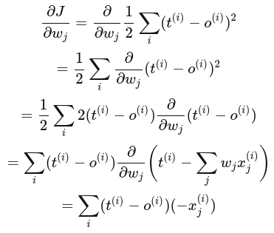



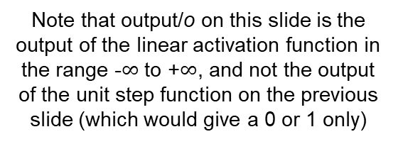
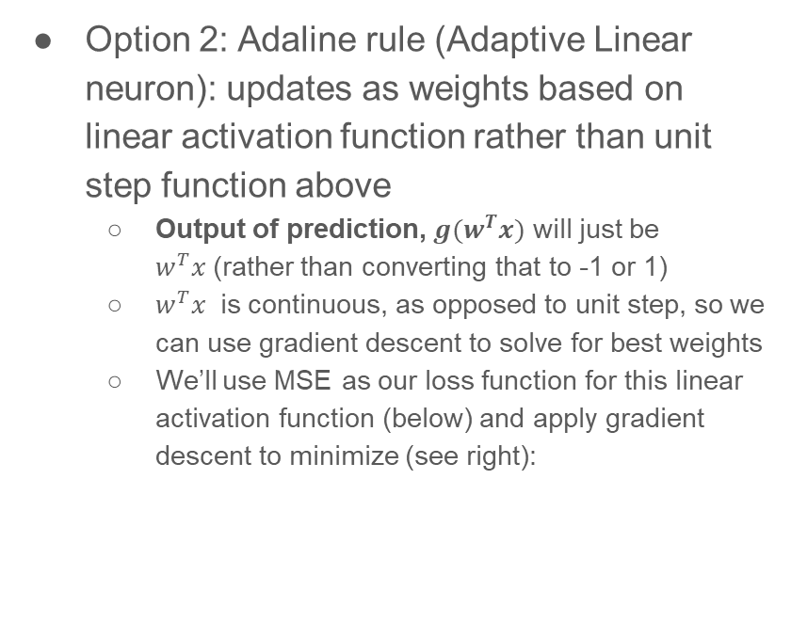
Learning rules for perceptrons
d/dx f(x)² = 2f(x) d/dx f(x)
Note that output/o on this slide is the output of the linear activation function in the range -$∞$ to +$∞$, and not the output of the unit step function on the previous slide (which would give a 0 or 1 only)
Option 2: Adaline rule (Adaptive Linear neuron): updates as weights based on linear activation function rather than unit step function above
Output of prediction, $g(w^{T}x)$ will just be $w^{T}x$(rather than converting that to -1 or 1)
$w^{T}x$ is continuous, as opposed to unit step, so we can use gradient descent to solve for best weights
We’ll use MSE as our loss function for this linear activation function (below) and apply gradient descent to minimize (see right):
gradient
change of weights
where
Images from https://sebastianraschka.com/Articles/2015_singlelayer_neurons.html

Slide 11
Training perceptrons
The previous slide is an example of batch learning that updates parameters after seeing the entire training dataset
Would only update the weights at the end of each iteration
Could use voting or averaging to decide how much to update the weights by, rather than the standard summing we just saw
You have the option of stopping the training algorithm early (before reaching max_iterations)
Convergence not guaranteed if data not linearly separable
It’s a good idea to scale/normalize your features in this case as well
Helps to find the right learning rate
Leads to faster convergence
Prevents the weights from becoming too small
More in a minute
See notes from https://sebastianraschka.com/Articles/2015_singlelayer_neurons.html

Slide 12
Perceptron training convergence
Training will converge if the perception classifies every sample correctly
It found the right “split” (hyperplane) for your dataset
Assumes dataset is linearly separable
Training time depends on the margin between classes
As opposed to the number of samples, nor number of features
Converges quickly when the margin is wide
These models are sensitive to noise
May not converge if you can’t cleanly split your data
In such cases, set a max number of iterations, and/or a threshold of tolerance when to stop learning

Slide 13

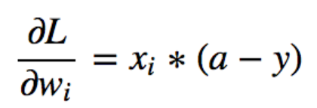




Importance of scaling/normalizing inputs:
Let’s examine these binary activation functions: logistic regression
Predicts between 0 and 1
Uses log loss (we simplified earlier expression):
y is our target
a is what the model predicted
Derivative of log loss (simplified)
For every weight w_{j}, (a – y) will be the same
Therefore, the differences between the gradients for each weight depend solely on x_{j}
If all inputs x_{j} have the same sign, all gradients will also have the same sign
This will cause the model performance/loss to “jump around” a lot during training!
If we normalize our inputs x_{j} (around 0) then their signs will vary (this is good)
You can also see why scaling our x_{j} would also be useful here also
$$j$$
conceptually
same as
$$j$$
Images from https://towardsdatascience.com/why-data-should-be-normalized-before-training-a-neural-network-c626b7f66c7d

Slide 14
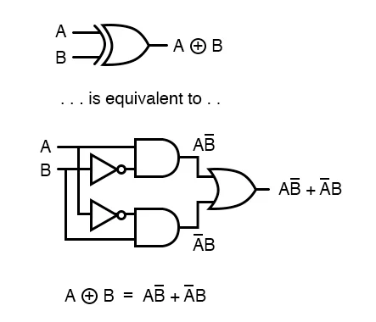
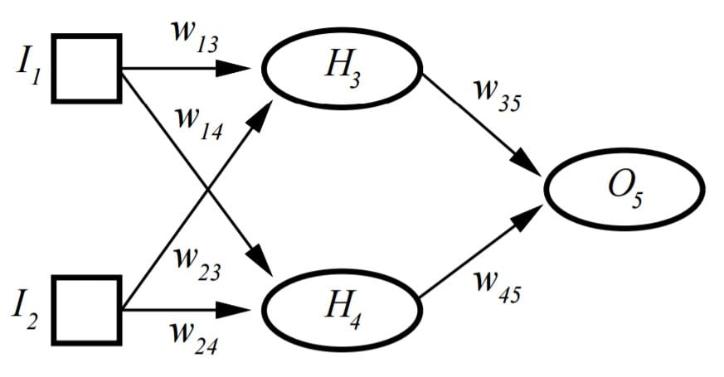
Decision making with perceptrons
Let’s recall perceptrons are like neurons, with an activation function
Perceptrons can implement certain logic gates:
OR: sum two inputs and check if output is positive or not
AND: sum two inputs and check if their sum exceeds a certain threshold
XOR: ???
XOR requires more than one perceptron to implement: multi-layer perceptron

Slide 15
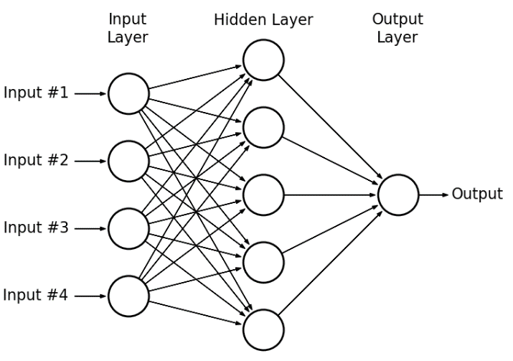
Multi-layer perceptrons
Mimicking our own brains, one can combine multiple perceptrons (neurons) into a chain
Has the shape of a net
Can handle much more complicated patterns in the data; extremely flexible
Can handle non-linear patterns in your data
The example at the right has a single hidden layer, but we can create arbitrarily deep models
Lots of hidden layers!
Allows us to learn a combination of features

Slide 16
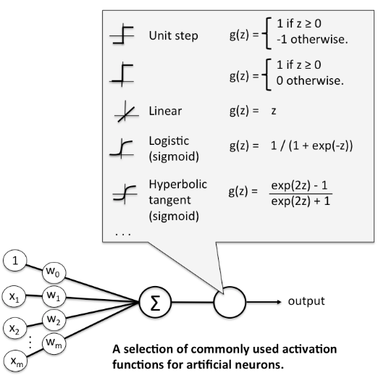
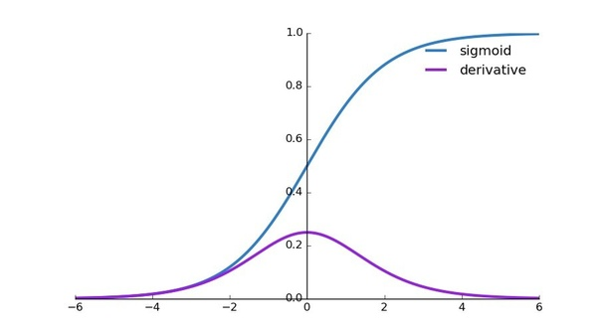
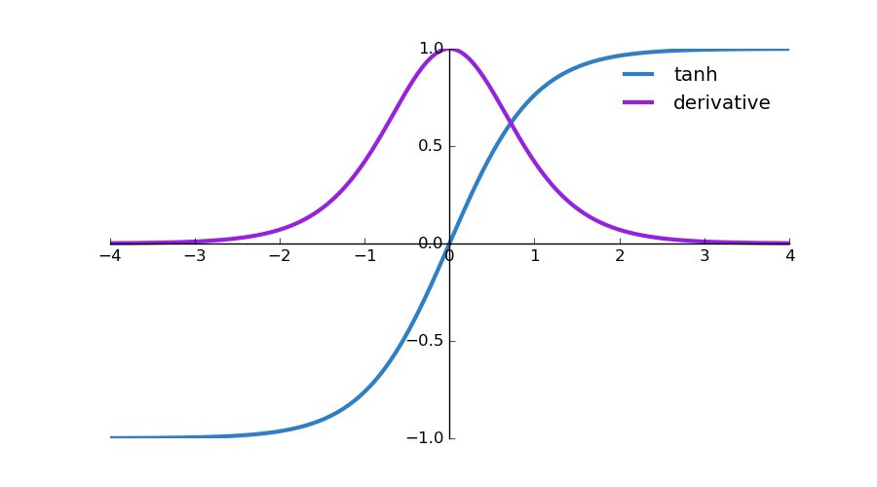
Possible activation functions
Sigmoid: useful if we care about activation probabilities
But suffers from problem on previous slides when inputs same sign
Use hyperbolic tangent instead
It is symmetric around the origin (inputs/outputs differ in sign)
Less likely to get trapped in local minima due to the derivatives being larger values near zero (in purple)
ReLu: most popular for deep learning
More on this later
Image from https://sebastianraschka.com/Articles/2015_singlelayer_neurons.html
Notes:
Discussion: https://stats.stackexchange.com/questions/330559/why-is-tanh-almost-always-better-than-sigmoid-as-an-activation-function

